Slide 1
22AIE315 NATURAL LANGUAGE PROCESSING L-T-P-C: 2- 0- 3- 3
Course Objective
The main objective of the course is to understand the leading trends and systems in Natural Language Processing. This course will help the students to understand the basic representations used in syntax, the semantics of Natural Language Processing. This course will help the students to understand and explore the models used for word/sentence representations for various NLP applications. This course will help the students to implement deep learning algorithms in Python and learn how to train deep networks for NLP applications.

Slide 2
Course Syllabus
Unit 1
Computational linguistics- Introduction, syntax, semantics, morphology, collocation and other NLP problems.
Unit 2
Word representation: One-hot encoding, Bag-of-Words (BoW) Dictionary: Term Frequency – Inverse Document Frequency (TF-IDF), Language Model-n-gram – Neural Network-based word embedding algorithms
Unit 3
Sequences and sequential data: Machine learning and deep learning for NLP, Recurrent Neural Network, Long Short-Term Memory networks, Gated Recurrent Unit - Sequence to sequence modelling - Encoder decoder - Attention mechanism, Transformer Networks – BERT, GPT, Graph NLP, Hidden Markov Model, Conditional Random Field, Topic modelling
Unit 4
Applications of NLP: Part-of-Speech tagging, Named Entity recognition, Dependency parsing, - Sentiment Analysis, Machine translation, Question answering, Text summarization, Evaluation metrics for NLP models and Visualization

Slide 3
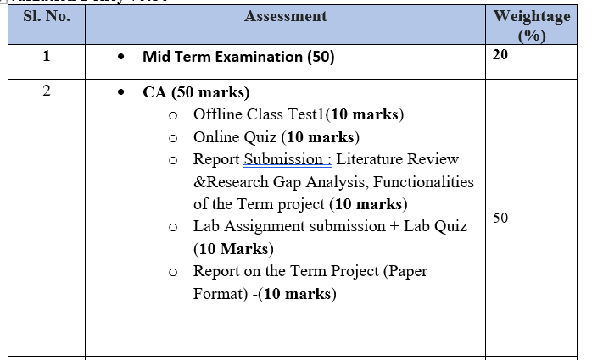
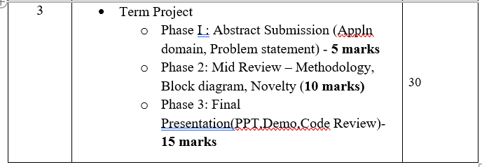
Evaluation Pattern 70:30

Slide 4
INTRODUCTION TO NATURAL LANGUAGE PROCESSING

Slide 5
What is NLP?
Natural Language Processing (NLP) is the sub-field of Computer Science especially Artificial Intelligence (AI) that is concerned about enabling computers to understand and process human language.

Slide 6
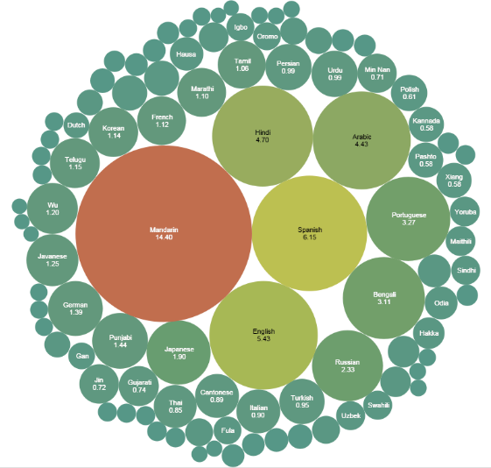
Why study NLP?
Text is the largest repository of human knowledge.
NLP is all about processing data.
Sources:News articles, web pages, scientific articles, patents, emails, government documents ,Tweets, Facebook posts, comments, Quora

Slide 7
Popular applications of NLP:
Machine Translation.
Speech Recognition. ...
Sentiment Analysis. ...
Question Answering. ...
Automatic Summarization. ...
Chatbots. ...
Market Intelligence. ...
Text Classification.

Slide 8
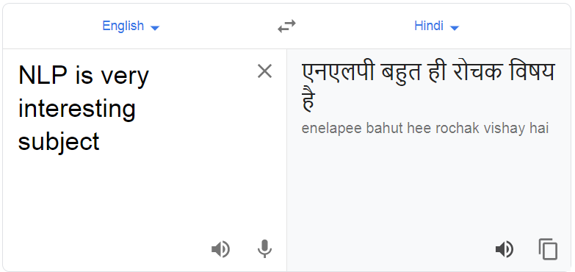
Machine Translation.

Slide 9
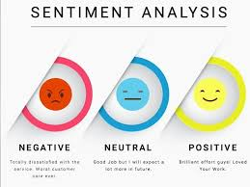
Sentiment Analysis
Sentiment analysis is the interpretation and classification of emotions (positive, negative and neutral) within text data using text analysis techniques.
Sentiment analysis tools allow businesses to identify customer sentiment toward products, brands or services in online feedback.

Slide 10
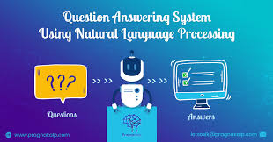
Question Answering
Question Answering is concerned with building systems that automatically answer questions posed by humans in a natural language.

Slide 11
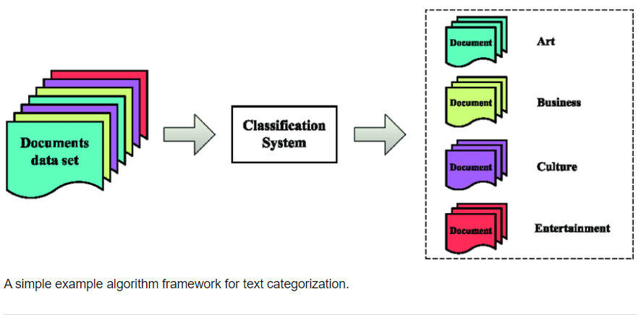
Text Classification

Slide 12
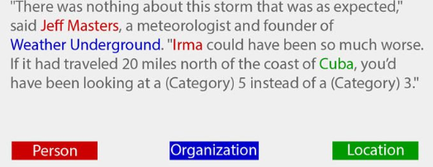
Named-entity recognition
(NER) locate and classify named entities in text into pre-defined categories such as the names of persons, organizations, locations, expressions of times, quantities.

Slide 13

Chatbot
A chatbot is a computer program that's designed to simulate human conversation.
Users communicate with these tools using a chat interface or via voice, just like they would converse with another person.

Slide 14
Examples Chatbot
Weather bot. Get the weather whenever you ask.
Grocery bot. Help me pick out and order groceries for the week.
News bot. Ask it to tell you when ever something interesting happens.
Life advice bot. I’ll tell it my problems and it helps me think of solutions.
Personal finance bot. It helps me manage my money better.
Scheduling bot. Get me a meeting with someone on the Messenger team at Facebook.
A bot that’s your friend. In China there is a bot called Xiaoice, built by Microsoft, that over 20 million people talk to.

Slide 15
Other Popular applications of NLP:
Speech Recognition. ...
Automatic Summarization. ...
Market Intelligence. ...
Spam Detection

Slide 16
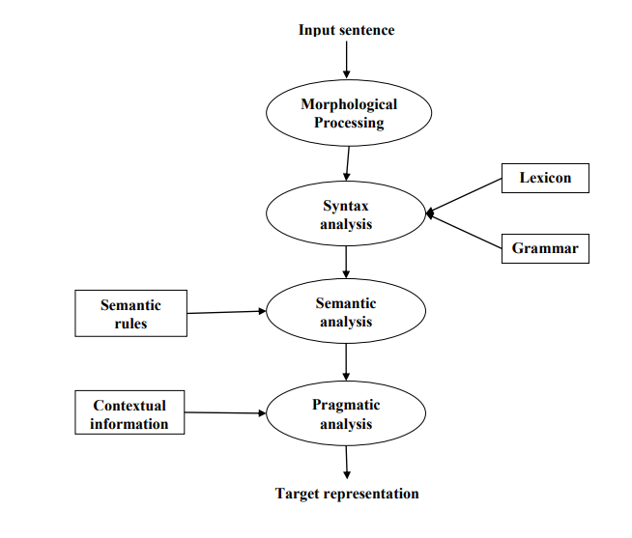
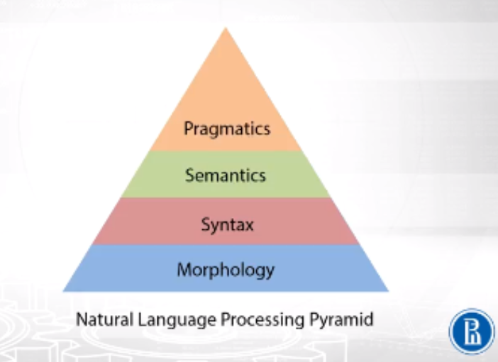
NLP Phases

Slide 17
Morphological Processing
First phase of NLP.
The purpose of this phase is to break chunks of language input into sets of tokens corresponding to paragraphs, sentences and words.
Word like “uneasy” can be broken into two sub-word tokens as “un-easy”.
Syntax Analysis
Second phase of NLP.
The purpose of this phase is two folds:
To check that a sentence is well formed or not.
To break it up into a structure that shows the syntactic relationships between the different words
The sentence like “The school goes to the boy” would be rejected by syntax analyzer or parser.

Slide 18
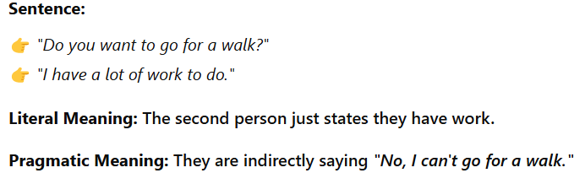
Semantic Analysis
Third phase of NLP. The purpose of this phase is to draw exact meaning.
The text is checked for meaningfulness.
Semantic analyzer would reject a sentence like “Hot ice-cream”.
Pragmatic Analysis
Fourth phase of NLP. Pragmatic analysis simply fits the actual objects/events, which exist in a given context with object references obtained during the last phase (semantic analysis).
The sentence “It's cold in here.“A factual statement about the temperature.

Slide 19
Ambiguity and Uncertainty in Language
Ambiguity is the capability of being understood in more than one way.
Natural language is very ambiguous.
NLP has the following types of ambiguities:
Lexical Ambiguity
Syntactic Ambiguity
Semantic Ambiguity
Anaphoric Ambiguity
Pragmatic ambiguity

Slide 20
Lexical Ambiguity
The ambiguity of a single word is called lexical ambiguity.
Treating the word silver as a noun, an adjective, or a verb
Syntactic Ambiguity
Ambiguity occurs when a sentence is parsed in different ways.
“The man saw the girl with the telescope”.
It is ambiguous whether the man saw the girl carrying a telescope or he saw her through his telescope.

Slide 21
3. Semantic Ambiguity
semantic ambiguity happens when a sentence contains an ambiguous word or phrase.
“The car hit the pole while it was moving” is having semantic ambiguity
because the interpretations can be
“The car, while moving, hit the pole”
“The car hit the pole while the pole was moving”.

Slide 22
Anaphoric Ambiguity
This kind of ambiguity arises due to the use of anaphora entities in discourse.
The horse ran up the hill. It was very steep. It soon got tired. Here, the anaphoric reference of “it” in two situations cause ambiguity.
Pragmatic ambiguity
Such kind of ambiguity refers to the situation where the context of a phrase gives it multiple interpretations.
The sentence “I like you too” can have multiple interpretations like I like you (just like you like me), I like you (just like someone else does).

Slide 23
NLTK (Natural Language Toolkit)

Slide 24
The Natural language toolkit (NLTK) is a collection of Python libraries designed especially for identifying and tag parts of speech found in the text of natural language like English.
Installing NLTK
If we are using Anaconda, then a Conda package for NLTK can be built by using the following command
Downloading NLTK’s Data
pip install nltk
conda install -c anaconda nltk
import nltk
Nltk.download()

Slide 25
Text Processing basics
Tokenization
Removing stopwords
Stemming
Lemmatization

Slide 26
1.Tokenization
Tokenization may be defined as the process of breaking the given text, into smaller units called tokens.
Words, numbers or punctuation marks can be tokens.
It may also be called word segmentation.
Input − Bed and chair are types of furniture.
nltk.tokenize is the package provided by NLTK module to achieve the process of tokenization.

Slide 27
Tokenizing sentences into words
word_tokenize module
Used for basic word tokenization.
import nltk
nltk.download('punkt’)
from nltk.tokenize import word_tokenize
word_tokenize(‘This is my favourite book’)
WordPunktTokenizer Class
An alternative word tokenizer that splits all punctuation into separate tokens.
from nltk.tokenize import WordPunctTokenizer
tokenizer = WordPunctTokenizer()
tokenizer.tokenize("won't")

Slide 28
Tokenizing text into sentences
NLTK provides sent_tokenize module for this purpose.
import nltk
from nltk.tokenize import sent_tokenize
text = "Let us understand the difference between sentence & word tokenizer. It is going to be a simple example."
sent_tokenize(text)

Slide 29
2.Remove Stop words
Some common words that are present in text but do not contribute in the meaning of a sentence.
The most common stop words are ‘the’ and ‘a’.
NLTK stopwords corpus
nltk.download('stopwords’)
from nltk.corpus import stopwords
stopwords.words('english’)
english_stops = set(stopwords.words('english’))
words = ['I', 'am', 'a', 'writer’]
[word for word in words if word not in english_stops]
from nltk.corpus import stopwords

Slide 30
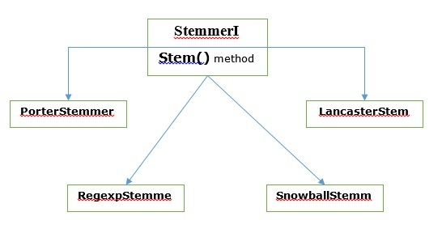
3.Stemming
Stemming is a technique used to extract the base form of the words by removing affixes from them.
It is just like cutting down the branches of a tree to its stems.
For example, the stem of the words eating, eats, eaten is eat.
Various Stemming algorithms

Slide 31
Porter stemming algorithm
Most common stemming algorithms
Designed to remove and replace well-known suffixes of English words.
PorterStemmer class
import nltk
from nltk.stem import PorterStemmer
word_stemmer = PorterStemmer()
word_stemmer.stem('writing')

Slide 32
Lancaster stemming algorithm
LancasterStemmer class
import nltk
from nltk.stem import LancasterStemmer
Lanc_stemmer = LancasterStemmer()
Lanc_stemmer.stem('eats')

Slide 33
Regular Expression stemming algorithm
RegexpStemmer class
import nltk
from nltk.stem import RegexpStemmer
Reg_stemmer = RegexpStemmer('ing')
Reg_stemmer.stem('eating')

Slide 34
Snowball stemming algorithm
SnowballStemmer class
import nltk
from nltk.stem import SnowballStemmer
SnowballStemmer.languages
French_stemmer = SnowballStemmer('french’)
French_stemmer.stem ('Bonjoura')

Slide 35
4. Lemmatization
Lemmatization technique is like stemming.
The output we will get after lemmatization is called ‘lemma’, which is a root word.
After lemmatization, we will be getting a valid word that means the same thing.
NLTK provides WordNetLemmatizer class which is a thin wrapper around the wordnet corpus.
This class uses morphy() function to the WordNet CorpusReader class to find a lemma
import nltk
nltk.download('wordnet')
nltk.download('omw-1.4')
from nltk.stem import WordNetLemmatizer
lemmatizer = WordNetLemmatizer()
lemmatizer.lemmatize('books')

Slide 36
Difference between Stemming & Lemmatization
Stemming uses the stem of the word, while lemmatization uses the context in which the word is being used.
Stemming algorithms work by cutting off the end or the beginning of the word, taking into account a list of common prefixes and suffixes that can be found in an inflected word.
Lemmatization, on the other hand, takes into consideration the morphological analysis of the words
import nltk
from nltk.stem import PorterStemmer
word_stemmer = PorterStemmer()
word_stemmer.stem('studies’)
Output : Studi
import nltk
nltk.download('wordnet')
nltk.download('omw-1.4')
from nltk.stem import WordNetLemmatizer
lemmatizer = WordNetLemmatizer()
lemmatizer.lemmatize('studies’)
Output : study

